Slide 1

INVEST CONNECT
Marketplace
Home
Contact
Empowering Connections, Enabling Growth
AEHESKFJ SLKF;RDK;GDFLGDGL
VIDEO
Ehfkejfleflk;lfk;ewplf’wefew’[f;we’flewf’welf’;wefefjlewfk;elfkwe;fkew;fkwe;fkewf;wekf;welfkwfkew;fk;wekf’we;fkwe;fkwe;fkwe;fkwe;
I am looking to
Invest
Fundraise
Professional help
Hero Section with Tagline and Introduction

Slide 2
Our Unique Selling Proposition (USP):
Invest Connect Marketplace is the first angel investment platform designed with a three-pillar user model to serve investors, entrepreneurs, and professional service providers. By bringing these essential players together on a single, streamlined platform, we offer a comprehensive ecosystem that fuels growth, collaboration, and investment success. Our vision is to establish Invest Connect Marketplace as the leading destination for angel investors and business owners looking to connect and innovate. We’re here to drive unmatched opportunities and transform the investment landscape for everyone involved.
Join Invest Connect Marketplace Today—Where Opportunity and Growth Converge. Discover the Future of Angel Investing

Slide 3
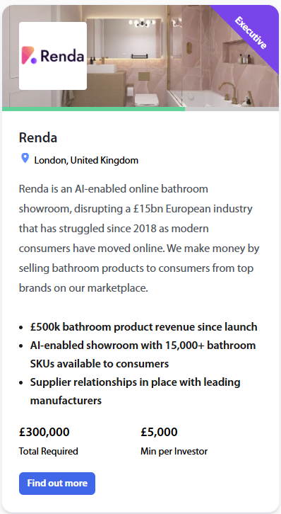
.
Investor Pitch Deck Showcase.
Layout -A dynamic gallery or a carousel previewing pitch decks, each with a short description.
Exploring Investment Opportunities in the UK?
Explore curated UK pitch decks from promising entrepreneurs, poised to make a lasting impact
Browse innovative business ideas, startups, and funding needs from entrepreneurs across the UK
Browse Pitch Deck

Slide 4

Our Trusted Partners
Logos or banners of key partners with brief descriptions or links to their services
Want to see yourself here?
Contact Us

Slide 5
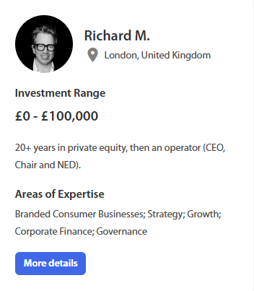
.
Investor Profiles for Entrepreneurs, Entrepreneurs can view profiles of active investors and learn about their interests and backgrounds. Profile cards showing investor names, industries, and investment preferences
Meet Potential Investors
Explore curated UK pitch decks from promising entrepreneurs, poised to make a lasting impact
"Connect with thousands of investors ready to shape your idea and fuel your growth."
View Investor Profiles

Slide 6
.
Investor Profiles for Entrepreneurs, Entrepreneurs can view profiles of active investors and learn about their interests and backgrounds. Profile cards showing investor names, industries, and investment preferences
Meet Industry Experts
Find trusted professional service providers to support your business growth, from legal advisors to financial consultants
Explore Service Providers

Slide 7
testimonial

Slide 8
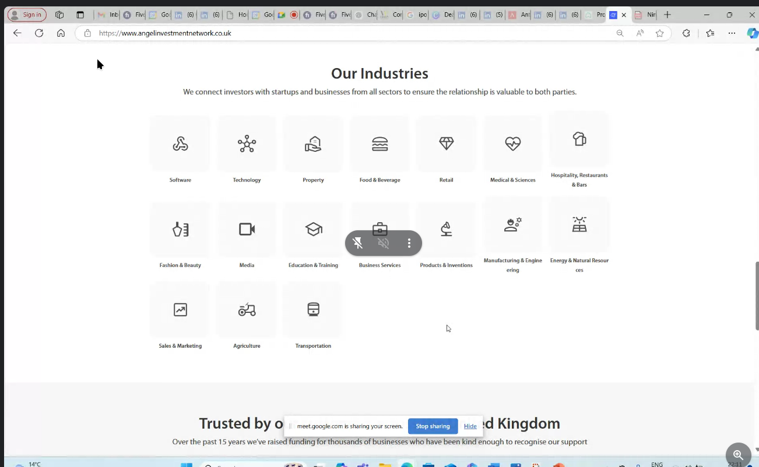
Type of Industries

Slide 9
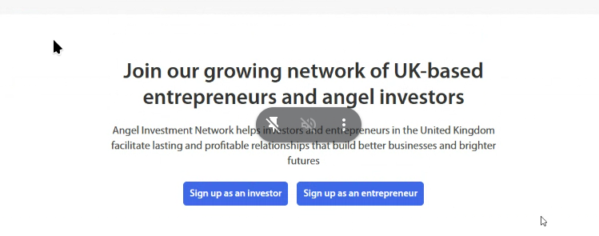

Slide 10
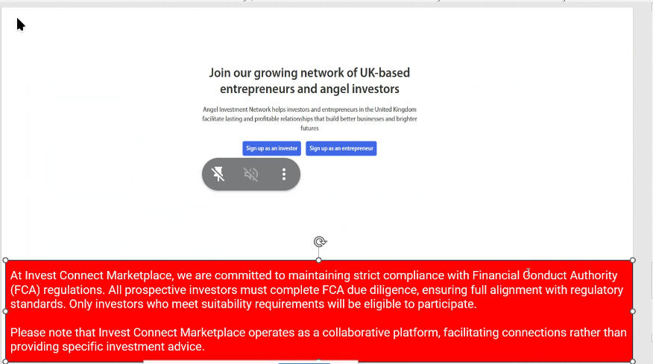

Slide 11
